Slide 1


Team 4 – Risky Business
Dave Kreitzer
Karim Ezzat
Tianyu Tap
Xander Roy

Slide 2

Project Overview
U of MN Department of Political Science
Professor Jane Lawrence Summer
Researching SEC 10K Risk Factors
“What percentage of a companies Risk Factors are focused on specific topics; i.e. employee wages”

Slide 3
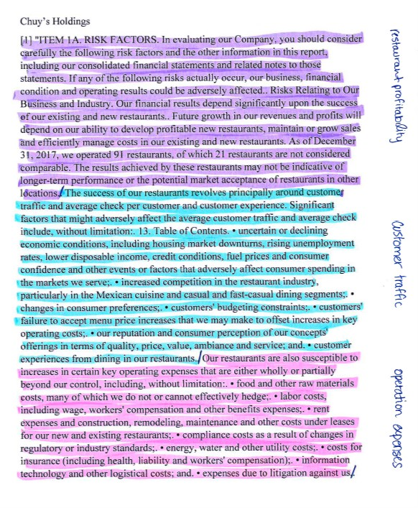
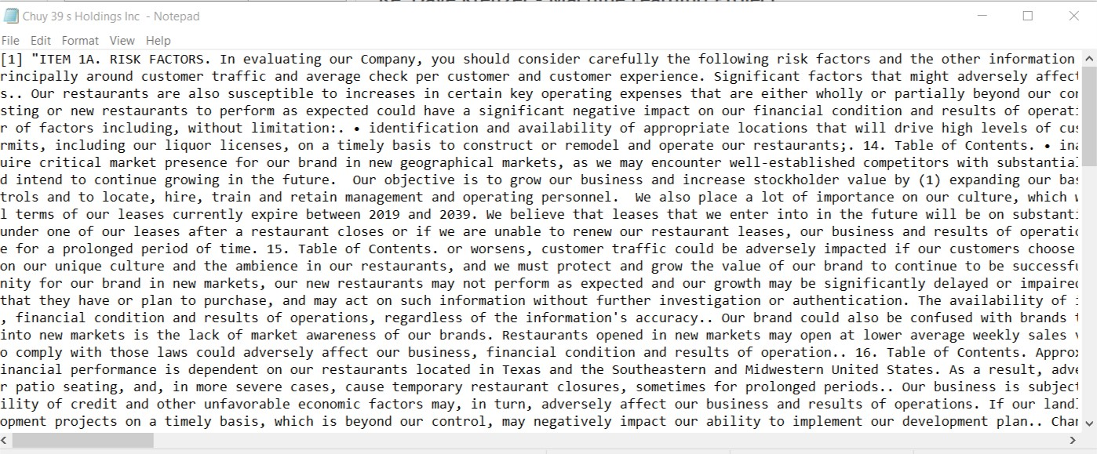
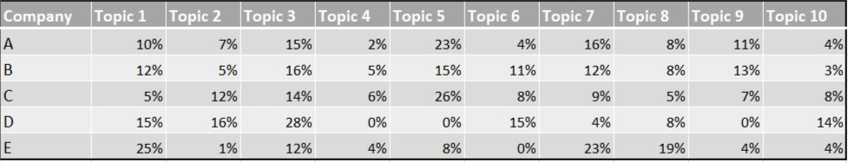
Why Machine Learning?
< 10 Hand-coded Samples
3,000 Scrapped Text Files
Table of Results

Slide 4
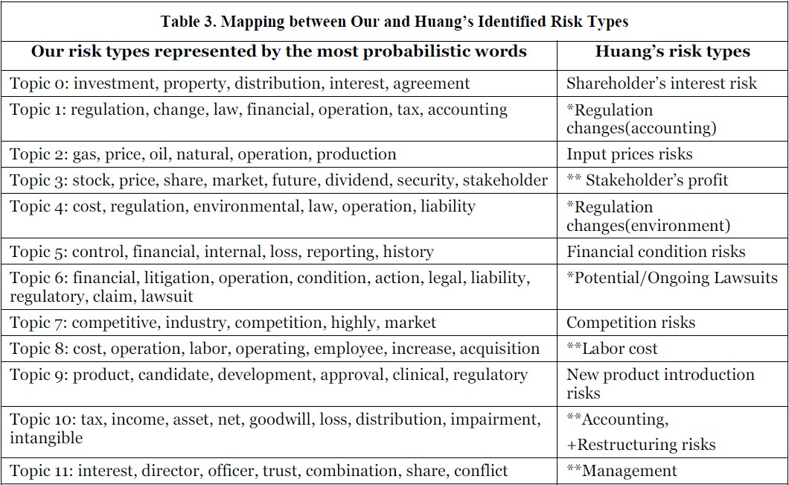
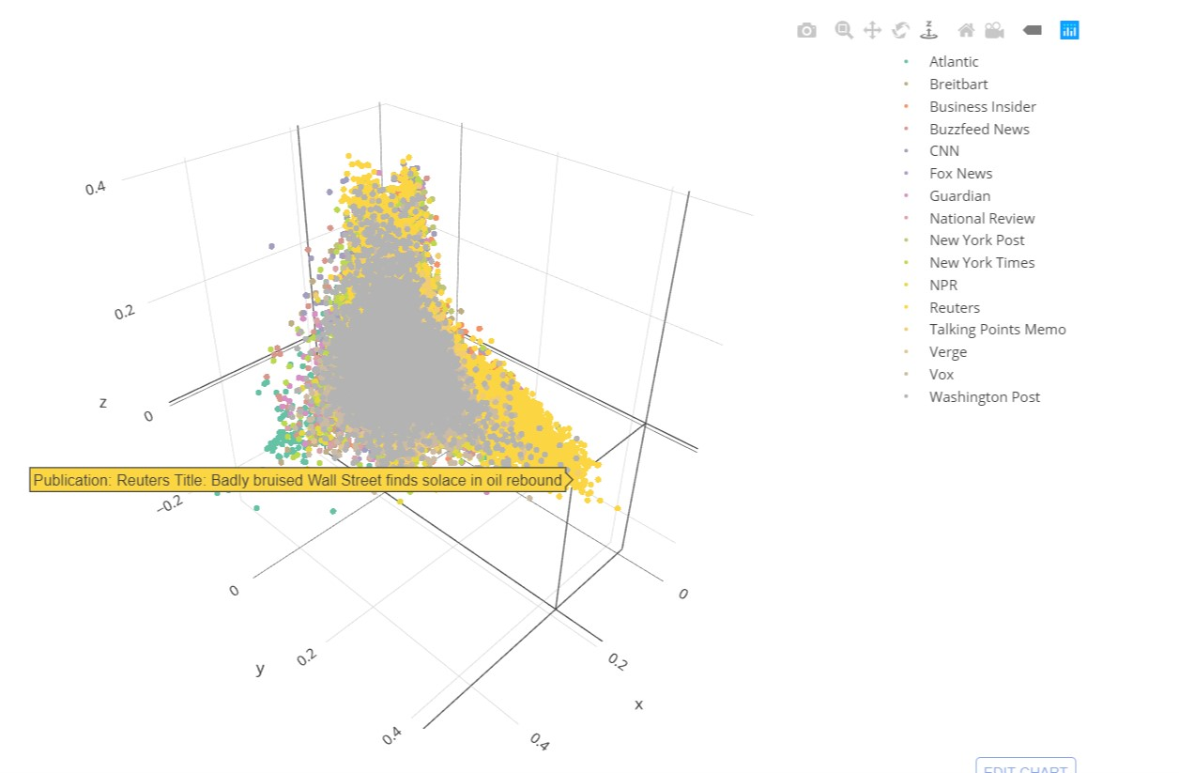
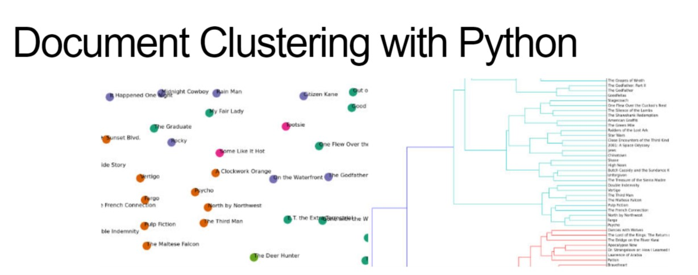
Researched Similar Projects
Summarization of Corporate Risk Factor Disclosure Through Topic Modeling
Research paper published in 2012
Sent-LDA modeling
Andrewsthompson.co
Clustering 143k articles with Kmeans
Brandonrose.org
KMeans clustering
LDA modeling

Slide 5
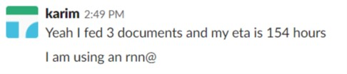
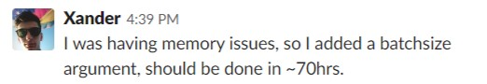
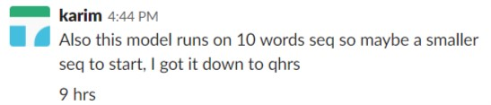
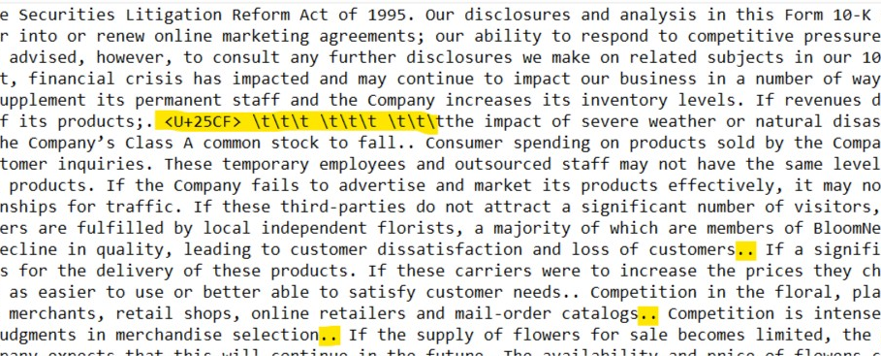
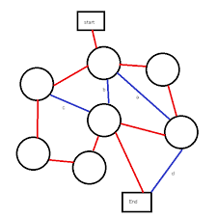
Challenges
Training an unsupervised model with RNN was going to take DAYS
Data was scrapped, so it required extensive cleaning.
Text was not broken into Paragraphs
So many different path options,
Not sure which if any will be successful,
Which should we choose?

Slide 6
Method 1
Files
Munge Files
Score
Tokenize Words
Model
Cluster Labels / Centroid Loc
Stem Words
Predicting
Filter Out Bad Words
Vectorize

Slide 7
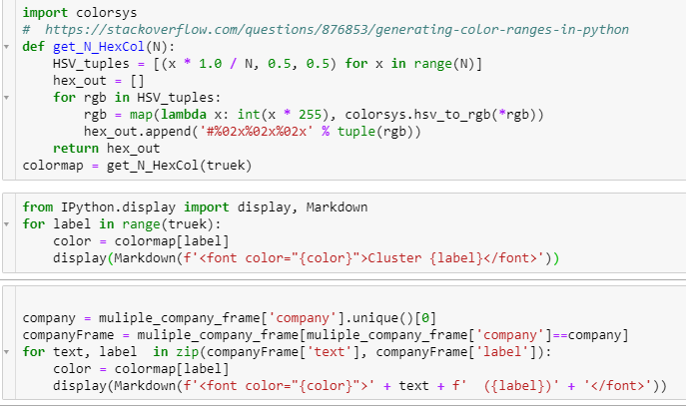
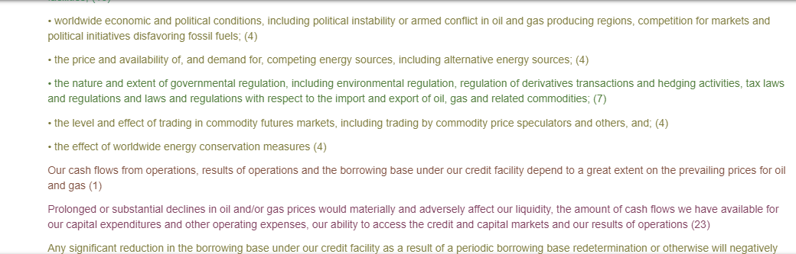
Method 1
<-- Code to Generate Text Output
Text File Output -->

Slide 8
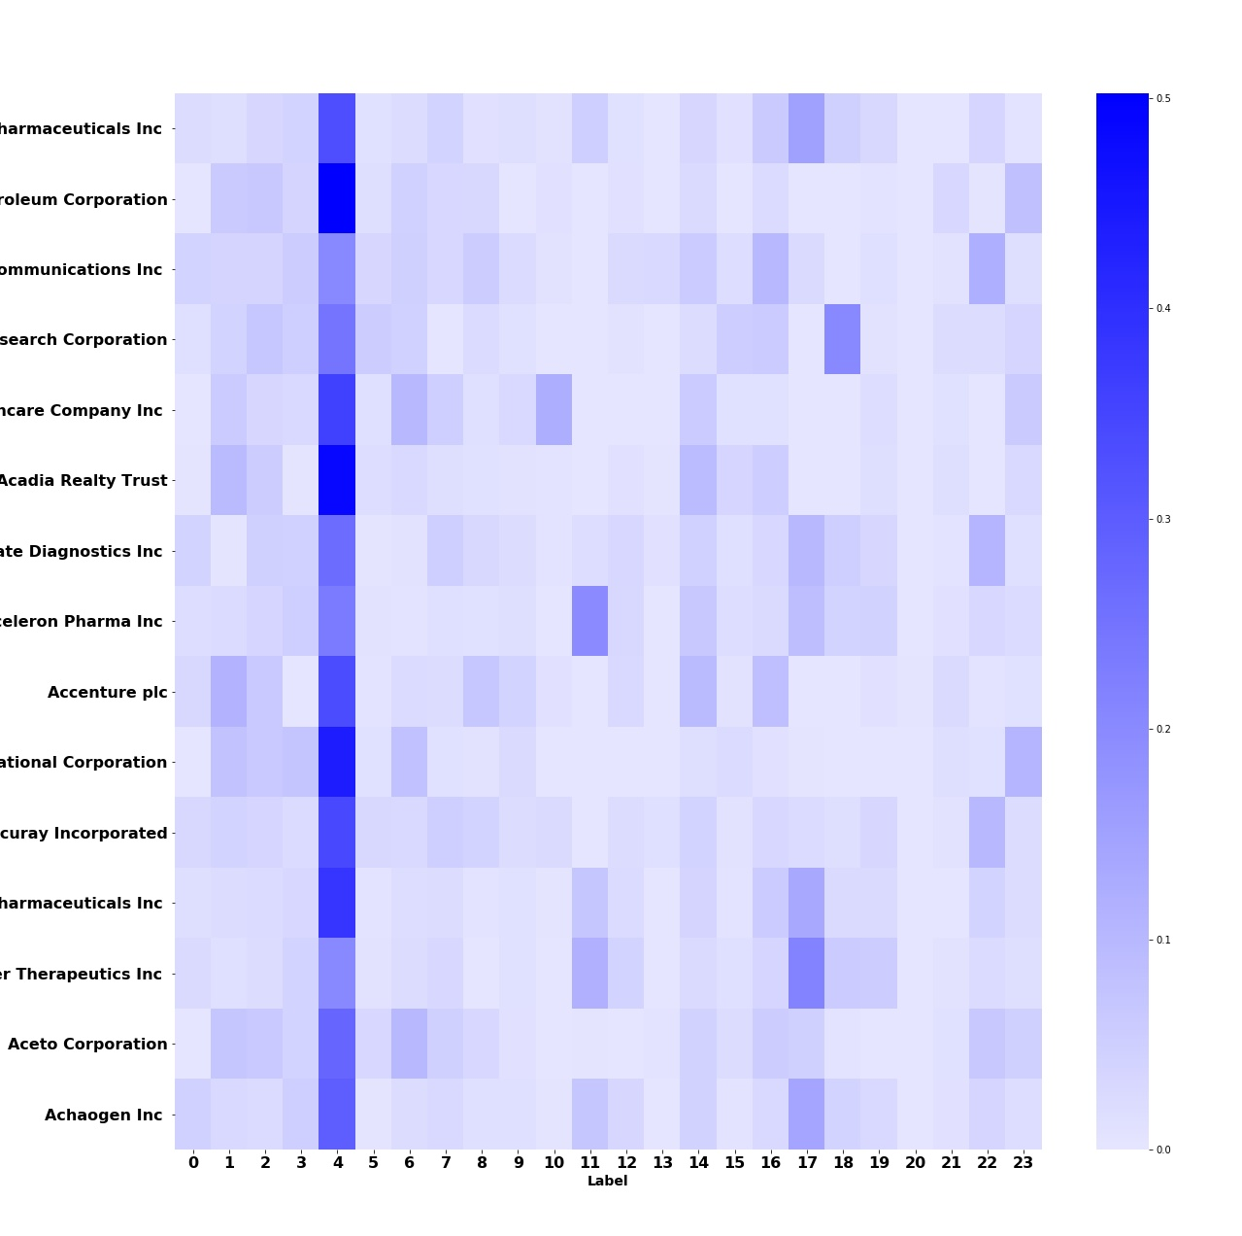
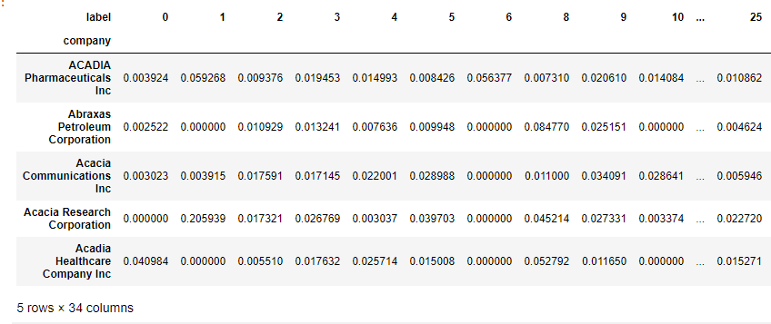
Method 1

Slide 9
Method 2
Files
50-dimentional
Vector represent word
Munge Files
Classification Algorithms
Words
Validating w/metrics
(silhouette score)
glove
(Global vector / words)
Predict / Verify

Slide 10
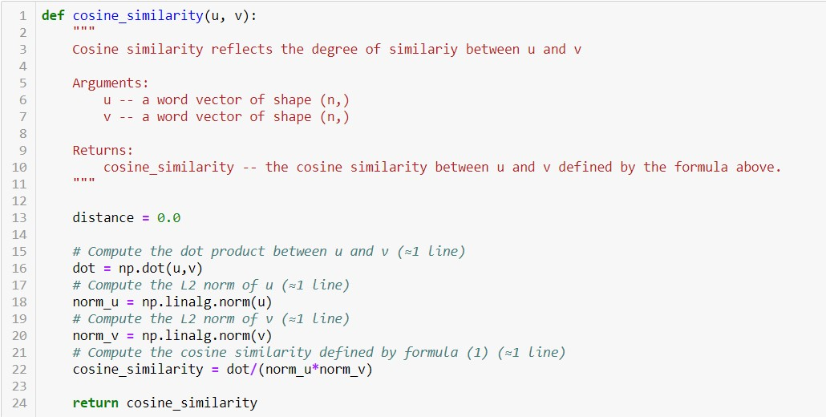
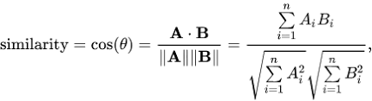
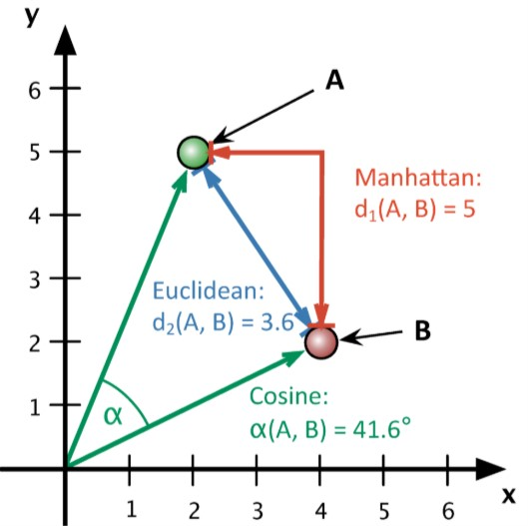
Method 2
Cosine Similarity

Slide 11

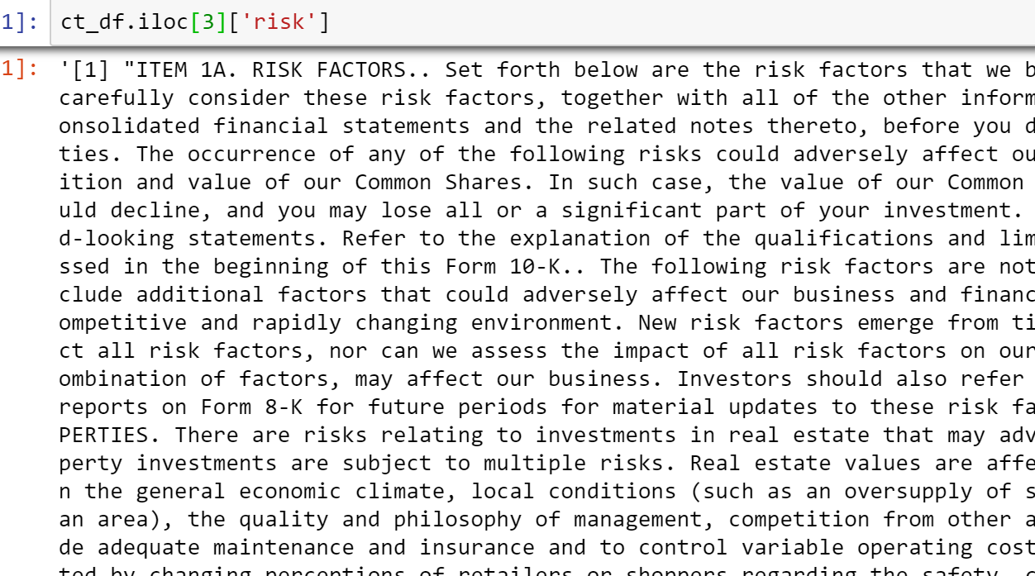
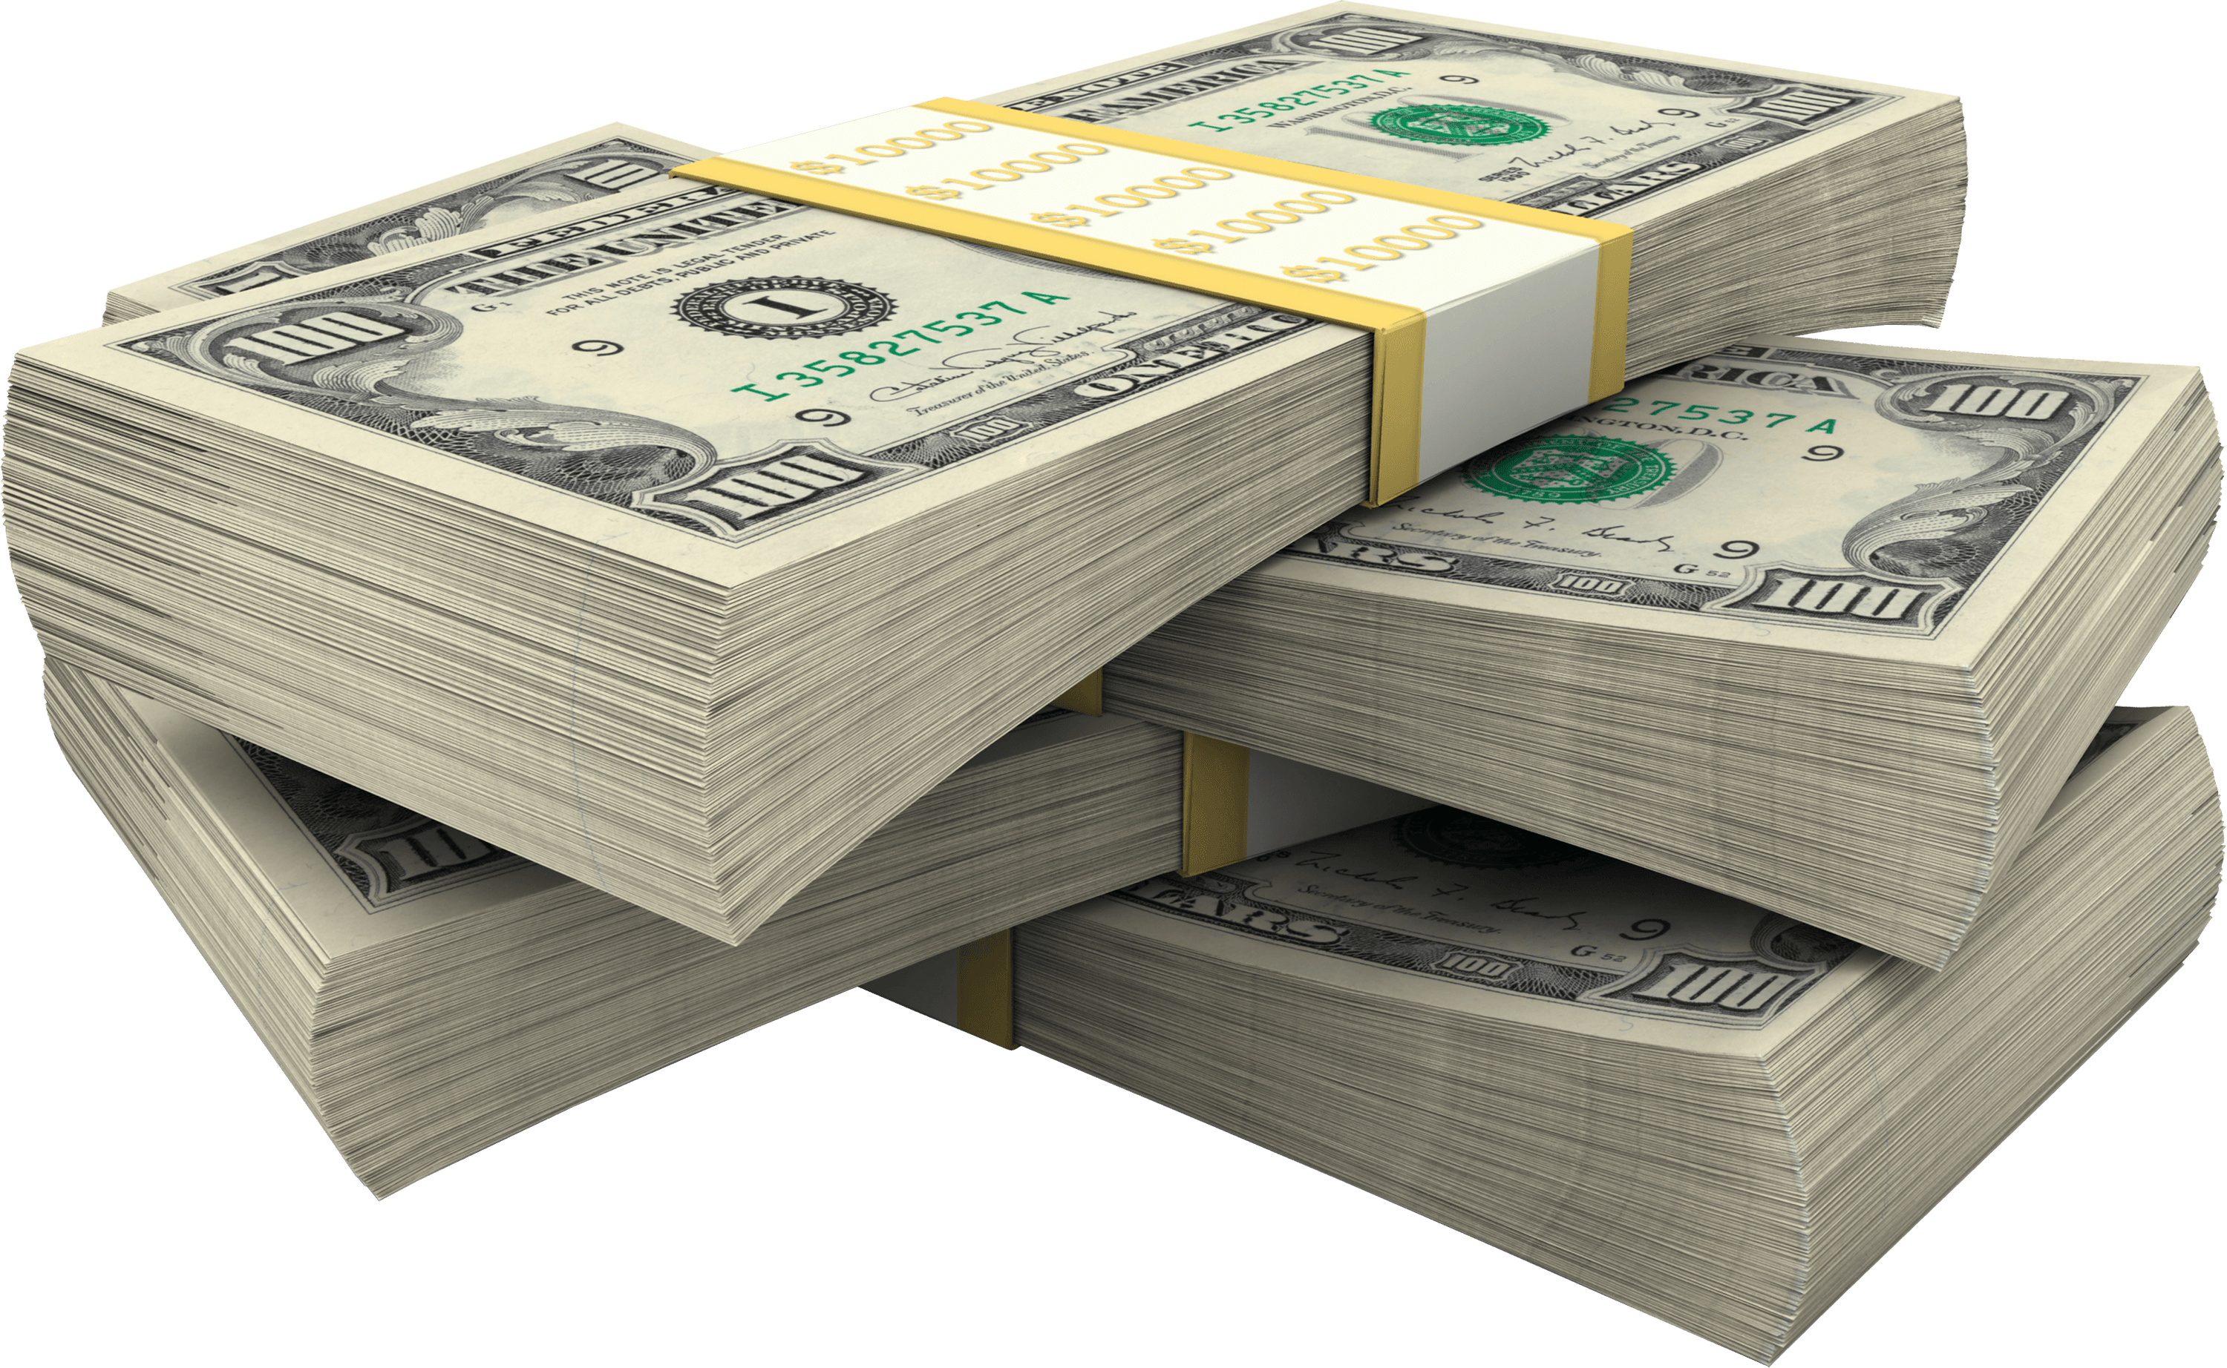
Model 3 Can we turn technical documents into Decisions?
SEC 10K item1A > Buy or Sell

Slide 12
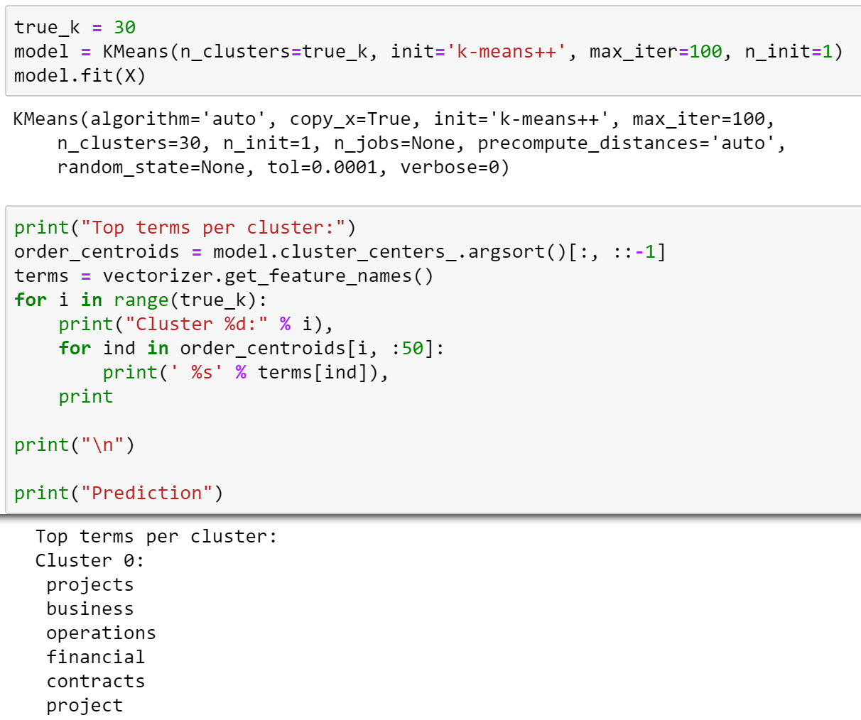
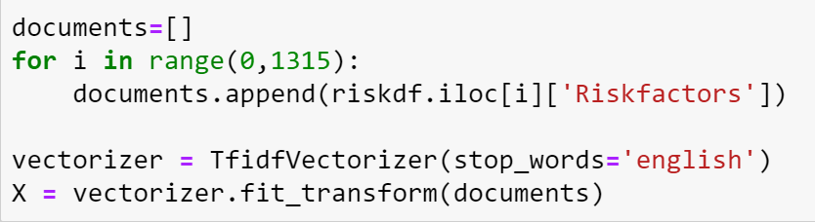
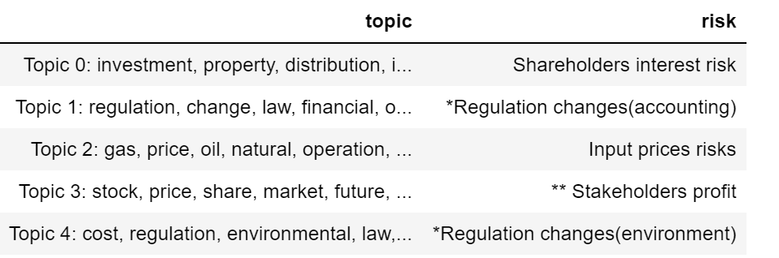
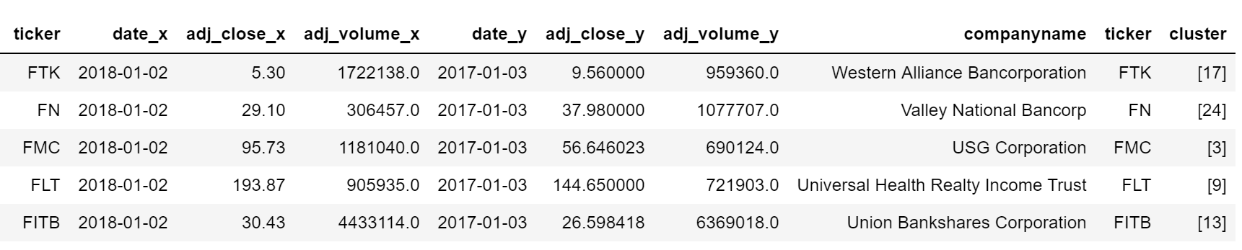
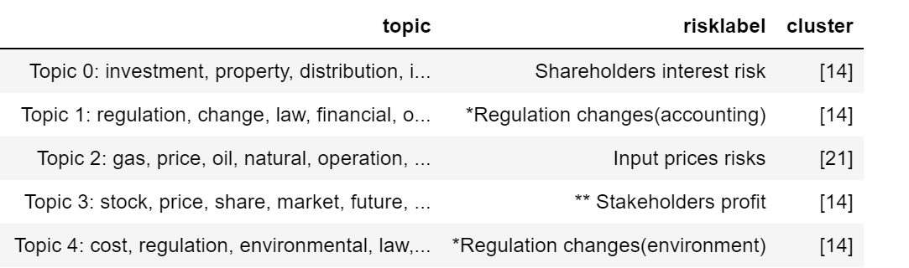
Method 3
Files
TF-IDF Vectorizer
Labels
Kmeans
Clusters
Validate
Correlation matrix
Clusters
Classify

Slide 13
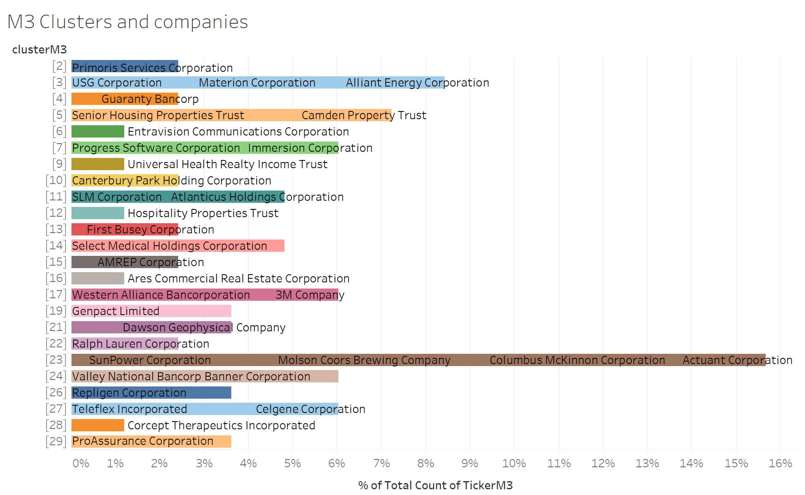
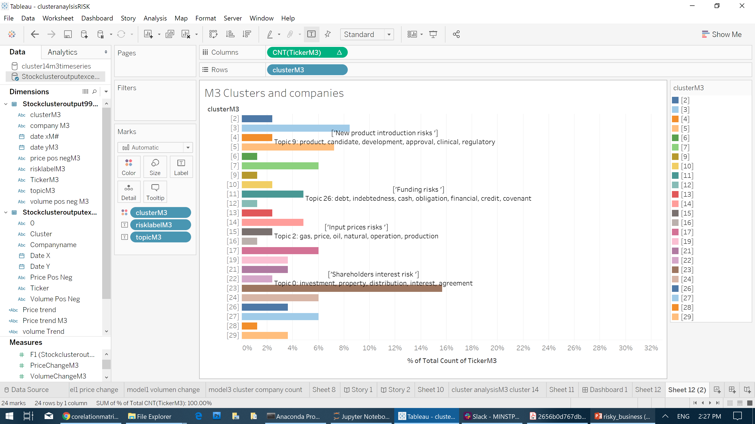
Cluster Classification
Method 3

Slide 14
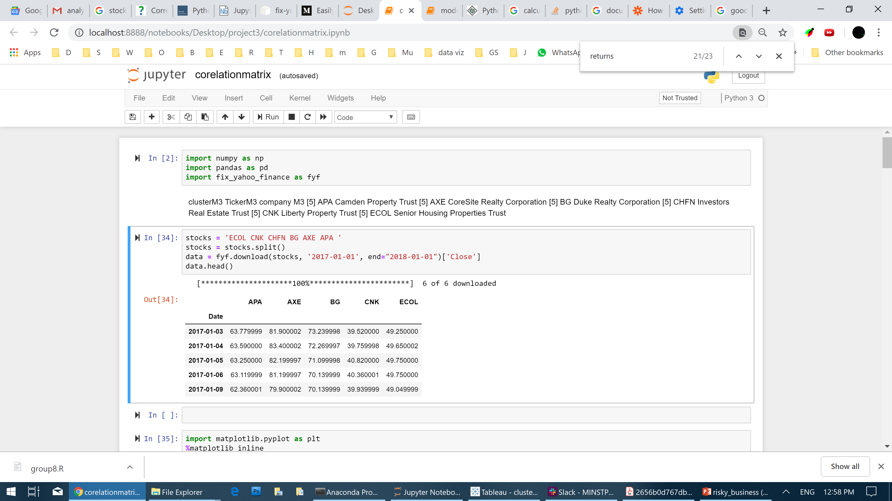
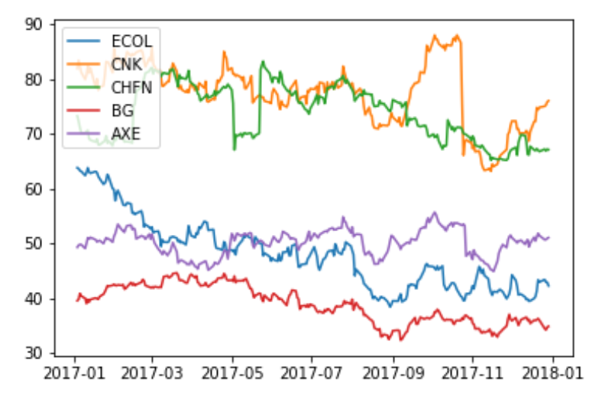
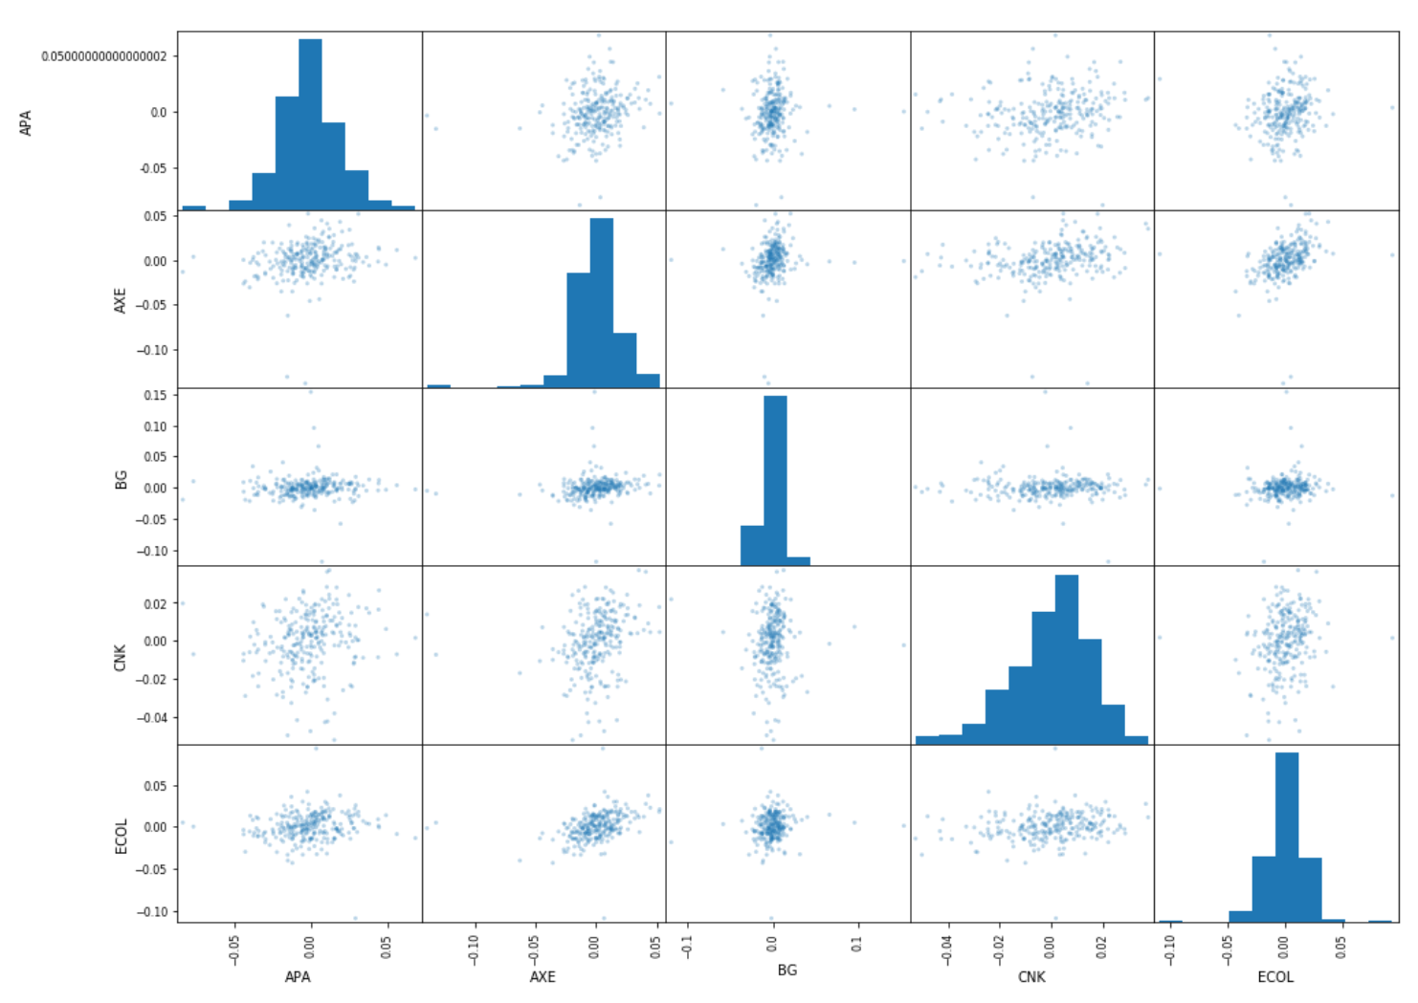
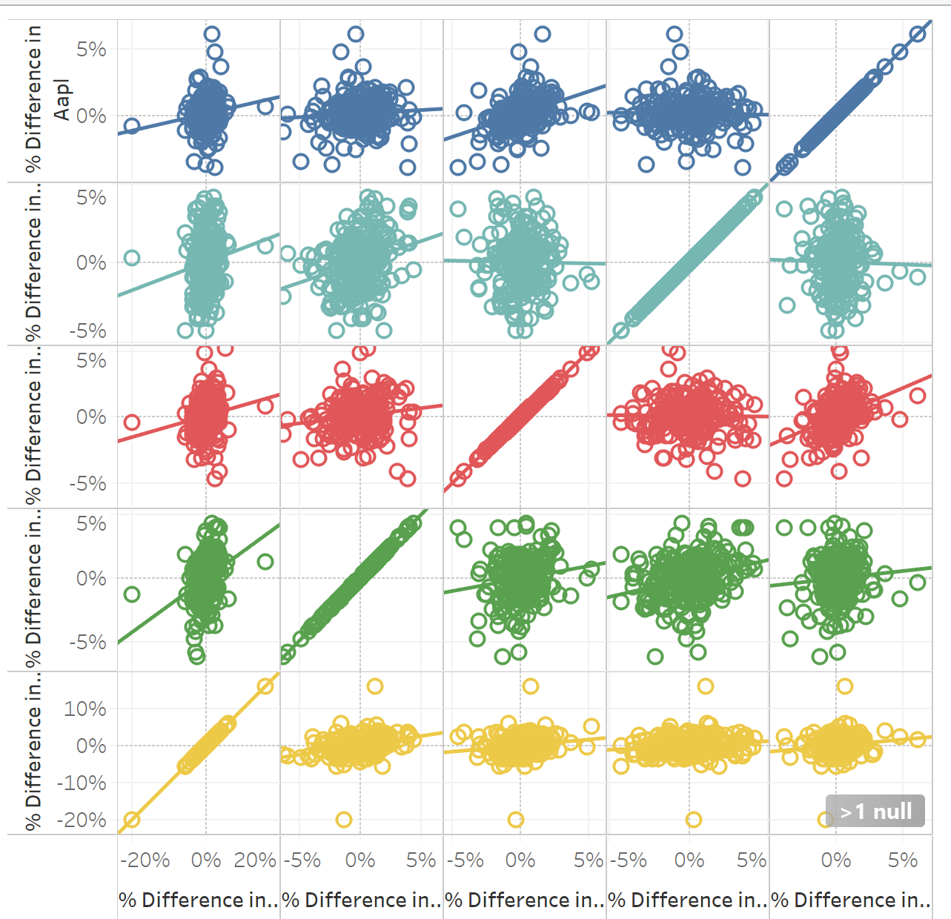
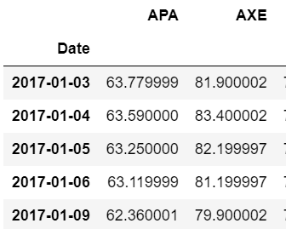
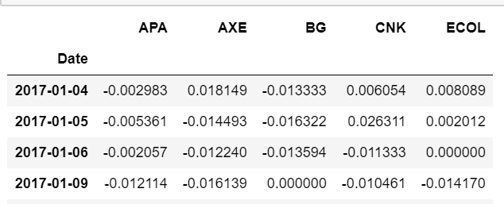
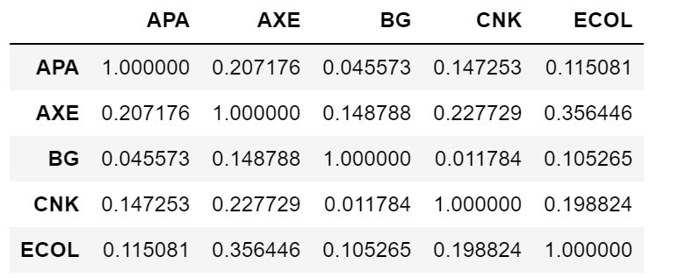
Validate via correlation matrix
Clusters in to market trend
Method 3
Do the stocks prices trend as a group…. Yes: we have a useful cluster
No:….oh oh!

Slide 15
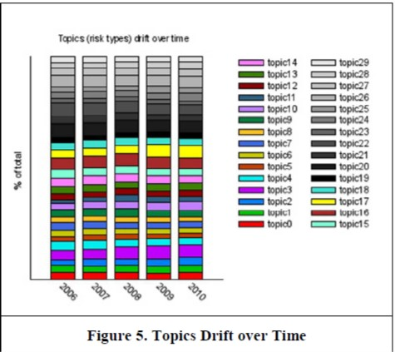
Next Steps Develop GUI to process, explore, and visualize data with little to no programming experience (i.e. Flask, Django, Online-Notebook)
Convert Notebook to Python app
Export color coded text files
Convert Data Frames to CSV
Parameter / model tuning
Connect target labels with generated clusters
Information collection
Scrape 10k Risk Assessments from EDGAR (SEC online data)
Scrape SIC Codes and Market Cap for analyzed companies

